Slide 1
Program of Studies
Overview
March 10, 2016

Slide 2
Agenda
Welcome - Jim O’Shea
Overview of the Program of Studies - Lisa Soldi
9th grade Transition - Scott Hoffman
Department Leaders
English - Janet Brown
Math - Russ Wass
Science - Deb Pierce
Social Studies - Kathleen Doherty
World Languages - Jen Fraser
Unified Arts - Tom Reynolds
Special Education - Catherine Polis
Sample Schedules - Drew Skrocki
Extra and Co-Curricular Involvement - Sara Lamere

Slide 3
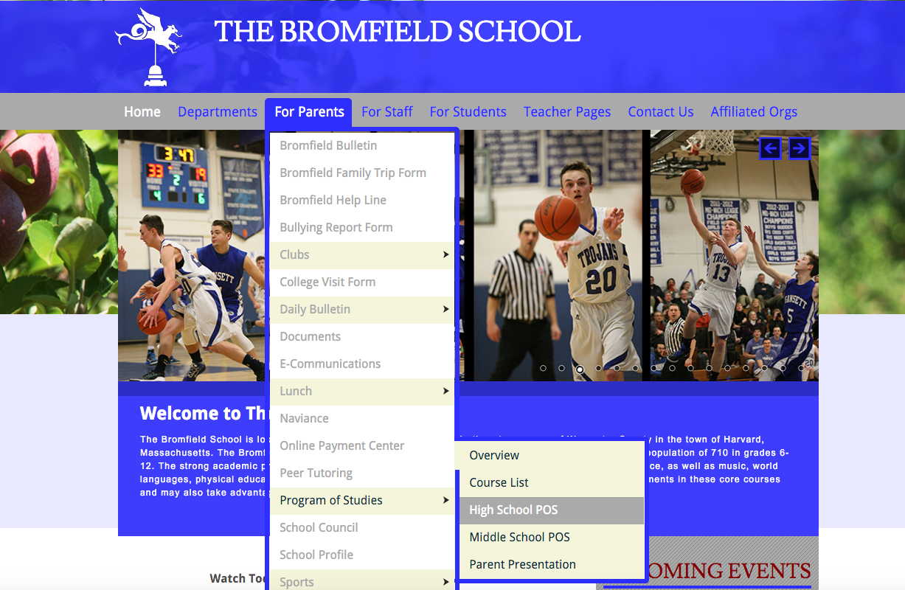
The Bromfield School Homepage

Slide 5
Academic Counseling
Please visit the Guidance website for information on:
Graduation Requirements
Post-Secondary Requirements
Standardized Testing

Slide 7
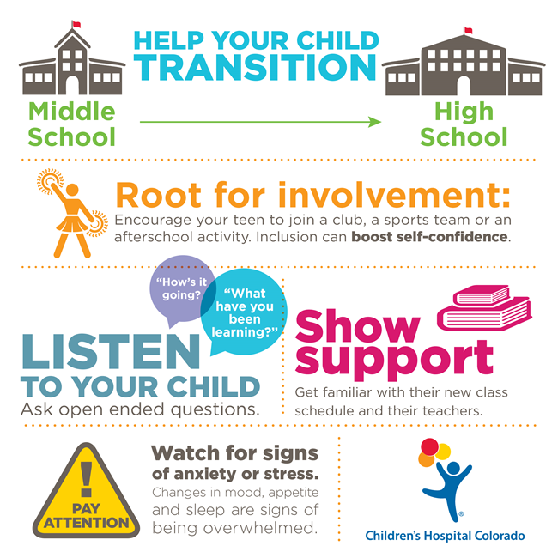

Slide 8




English at Bromfield: An Overview of English Department Offerings and Opportunities
Starting in 9th grade, English courses divide into two levels: College Preparatory and Honors.
  The prerequisite for Honors is an A- in addition to the teacher’s recommendation.
9th Grade: Introduction to Literature (CP, H)
10th Grade: Comparative Literature (CP, H)
11th Grade: American Literature (CP, H)
12th Grade: World Literature (CP)
British Literature (H)
Advanced Placement English Literature and Composition
English Electives
Department Leader: Janet Brown, jbrown@psharvard.org
Title | Eligibility | Duration
Journalism | Grades 9-12 | Full Year
Expository Writing | Grades 11-12 | Half Year
Creative Writing | Grades 11-12 | Half Year
Public Speaking Fundamentals | Grades 10-12 | Half Year

Slide 9
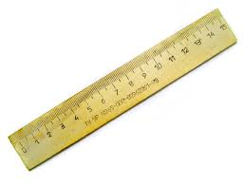
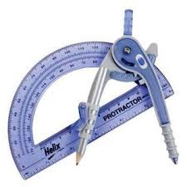
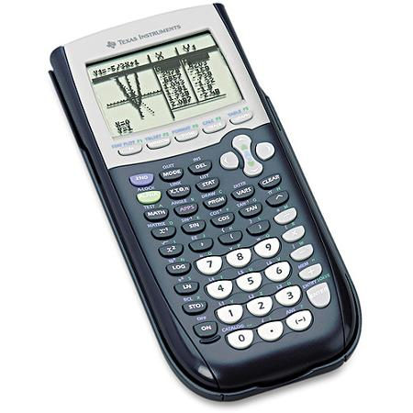
Mathematics Sequence
 | Version 1 | Version 2 | Version 3 | Version 4
Gr. 9 | Algebra II (H) | Algebra 1 | Geometry | Integrated Math I
Gr. 10 | Geometry(H) | Geometry | Algebra II | Integrated Math II
Gr. 11 | Pre-Calculus (H) | Algebra II | Trigonometry & Analysis | Integrated Math III
Gr. 12 | AP Calculus or Calculus(H) | Trigonometry & Analysis | Calculus (H) | Algebra II

Slide 10

GRADE 9
INTRODUCTION TO PHYSICS
Introduction to Physics ---no prerequisite
Introduction to Physics Honors---prerequisite: B+ in 8th grade physical science and B+ in Honors Algebra I with a strong recommendation from both of your science and math teachers. The math component of this course is significant. Students are more successful when they have a strong knowledge of Algebra I.
PLEASE NOTE:
Students taking Introduction to Physics will take the Physical Science MCAS in the spring. If they pass that exam, they will have met their state science graduation requirement and will not have to take a science MCAS in their sophomore year.
GRADE 10
Biology – no prerequisite
Honors Biology
Chemistry
Honors Chemistry
PLEASE NOTE:
All students must take and pass a course in Biology to graduate from High School.
Students may double up in biology and chemistry if they choose. However, they must meet the prerequisites to do so and both courses must fit into their daily school schedule.
GRADE 11
Chemistry
Honors Chemistry
Applied Physics (project based)
Honors Physics
AP Physics I
AP Biology
AP Chemistry (students must have had either
Chemistry or Honors Chemistry first)
Anatomy and Physiology
GRADE 12
Chemistry
Honors Chemistry
Applied Physics (project based)
Honors Physics
AP Physics I
AP Biology
AP Chemistry (students must have had either
Chemistry or Honors Chemistry first)
Anatomy and Physiology
Deborah Pierce—Biology
Science Department Leader
dpierce@psharvard.org
978.456.4162 ext. 4287

Slide 11


World Languages Offerings
Students who pursue the study of French or Spanish will:
Communicate in the language of study
Develop an appreciation and understanding of cultural similarities and differences
Be prepared to be a member of a global community
Read and understand authentic literature at age appropriate levels
Community with accuracy when writing, reflecting acquired skills
Develop a greater understanding of the English language
SEQUENCE- French
GRADE 8: French Grade 8
GRADE 9: French 2
GRADE 10: French 3
GRADE 11: French 4 Honors
GRADE 12: French 5 Honors
or AP French
SEQUENCE -Spanish
GRADE 8: Spanish Grade 8
GRADE 9: Spanish 2 or Spanish 2 Honors
GRADE 10: Spanish 3 or Spanish 3 Honors**
GRADE 11: Spanish 4 or Spanish 4 Honors**
GRADE 12: Spanish 5 Honors or AP Spanish
GRADES 9-12: Spanish 1
**Students who wish to change from non-honors to honors level classes must work independently over the summer and take the Honors level final from the previous year of study before the beginning of the next school year. The student must receive a minimum of 74% on the exam in order to change levels.
**Please contact Jennifer Fraser at jfraser@psharvard.org with any questions**
Two years of the same high school world language are presently required for grades 9-12 for admission into Massachusetts State Colleges/Universities. Students contemplating admission into private colleges should check individual college requirements.

Slide 14
Special Education
Special Education Coordinator - Catherine Polis
Grade 9 - Mary Ann Conte, Special Education Teacher
Grade 10-11 - Michelle Creaven, Special Education Teacher
Grade 11-12 - Marybeth Campbell, Special Education Teacher
Grades 9-12 - Dr. Susan Downing, School Psychologist
Grades 9-12 - Dr. Debra Wiener, Speech and Language Pathologist
Specially Designed Instructional Services
The services are available for students who meet the eligibility criteria for special education. Services include small group classes that focus on study skills, reading and writing skills and math skills.
*Students are typically grouped by age/grade level into the lab classes and sessions.
Math Lab
Reading Lab
Writing Lab
Skills Lab
Social Skills
Counseling

Slide 15
Sample Schedules
H Intro to Literature 1 credit
Geometry 1 credit
Intro to Physical Science 1 credit
US History 1 credit
H Spanish II 1 credit
Physical Education ½ credit
Photography 1 credit
Study 0 credits Total credits 6 ½
Intro to Literature 1 credit
Algebra I 1 credit
Intro to Physical Science 1 credit
US History 1 credit
Spanish I 1 credit
Health ½ credit
Art Foundations ½ credit
Study 0 credits
Total credits 6

Slide 16


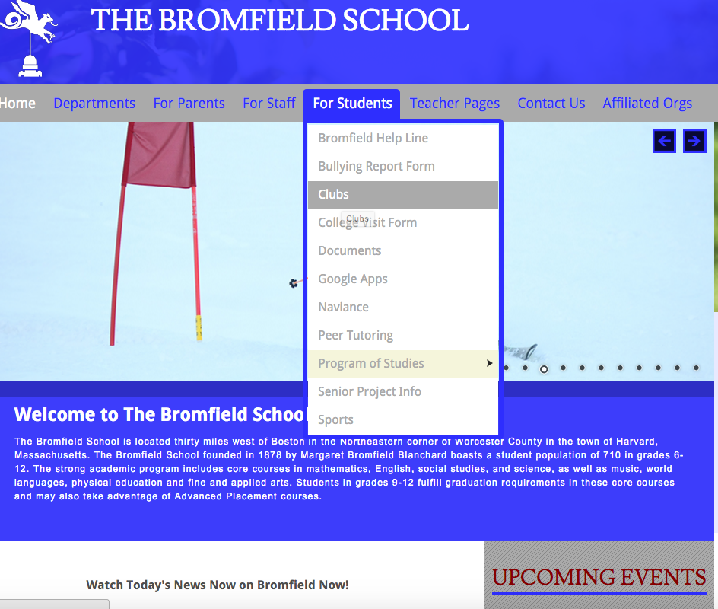




Extracurricular Involvement

Slide 17
Closing Remarks – Jim O’Shea
THANK YOU FOR COMING!!!!

